Slide 1

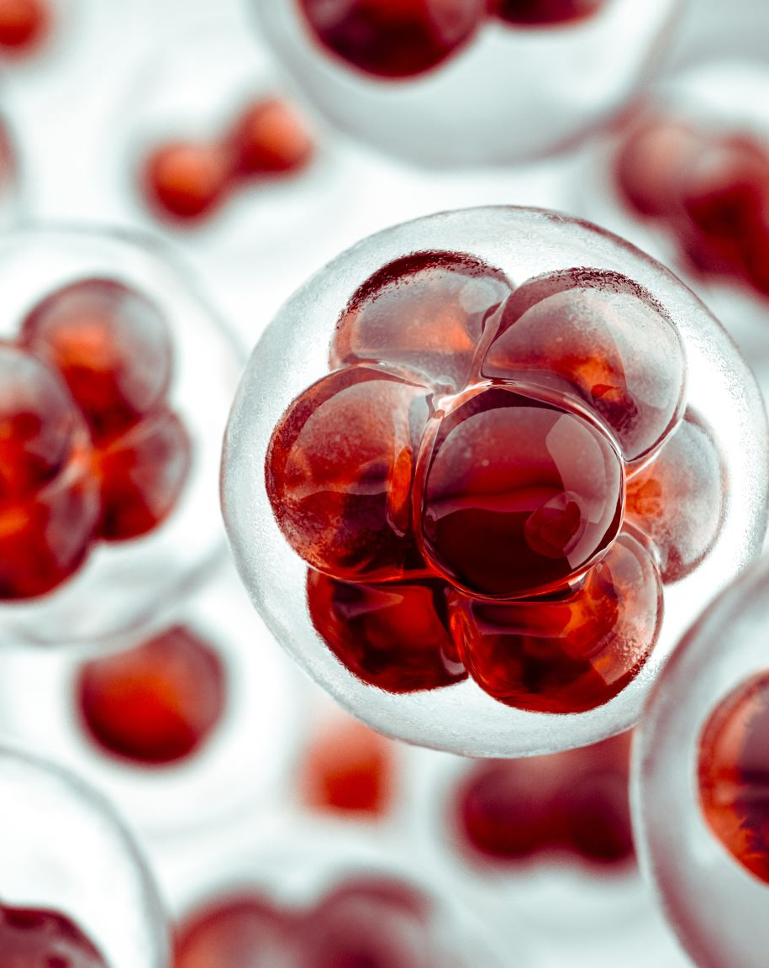
Membrane receptors for antigen
Dr. (Ms) Sonali Correa

Slide 2
INTRODUCTION
the body is defended by innate immune responses, but these will only work to control pathogens that have certain molecular patterns or that induce interferons and other secreted yet non-specific defences
Most crucially, they do not allow memory to form as they operate by receptors that are coded in the genome.
innate immunity is good for preventing pathogens from growing freely in the body, but it does not lead to the most important feature of adaptive immunity, which is long-lasting memory of specific pathogen.
To recognize and fight the wide range of pathogens an individual will encounter, the lymphocytes of the adaptive immune system have evolved to recognize a great variety of different antigens from bacteria, viruses, and other disease-causing organisms
Notes:
Early phases of the host response to infection depend on innate immunity in which a variety of innate resistance mechanisms recognize and respond to the presence of a pathogen. Innate immunity is present in all individuals at all times, does not increase with repeated exposure to a given pathogen, and discriminates between a group of related pathogens.

Slide 3
A receptor is a general term used for a molecule that receives signals from its ligands i.e. molecules it binds to
Receptors expressed on membranes have specific domains
Extracellular domain- specifically binds to ligands
Transmembrane – spans the plasma membrane
Cytoplasmic- participates in signal transduction
The receptors themselves or molecules associated with them link the exterior of the cell to the interior
In the duration of 60s-70s of last decade, the discovery of B cells and its participations on immune responses drew attention to the origin and functions of lymphocytes
Notes:
B cells partly organize the adaptive immune response and mediate humoral immunity, as well as perform several other roles critical to normal immune system function. For instance, they can generate immunological memory and produce high affinity antibodies.

Slide 4
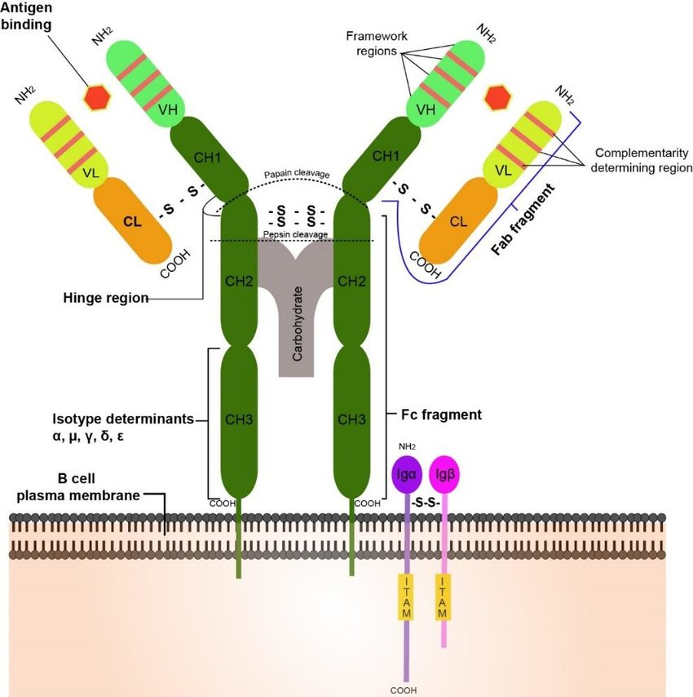
B cell antigen receptor
The antigen-recognition molecules of B cells are the immunoglobulins, or Ig.
These proteins are produced by B cells in a vast range of antigen specificities, each B cell producing immunoglobulin of a single specificity
Membrane-bound immunoglobulin on the B-cell surface serves as the cell's receptor for antigen, and is known as the B-cell receptor (BCR).
BCR consists of an antigen-binding transmembrane Ig (mIg) in complex with 2 transmembrane polypeptides viz. Igα, Igβ containing tyrosine activation motifs ( ITAMs) which enable transmission of intracellular signalling

Slide 5
Structure
The BCR is a transmembrane protein complex comprising multiple subunits including polypeptide chains of two identical Ig heavy chains (IgHC) having disulfide (-s-s-) bonds in between
B cell receptors are made up of four peptides – two light chains and two heavy chains – that comprise two antigen-binding regions.
Light chains are classified as either kappa or lambda, while the heavy chains can be IgG, IgA, IgM, IgD, or IgE isotypes.

Slide 6
B cell development in the bone marrow
B
Regulates construction of an antigen receptor
B
Ensures each cell has only one specificity
B
Checks and disposes of self-reactive B cells
B
Exports useful cells to the periphery
B
Provides a site for antibody production
Bone Marrow provides a
MATURATION & DIFFERENTIATION MICROENVIRONMENT
for B cell development

Slide 7
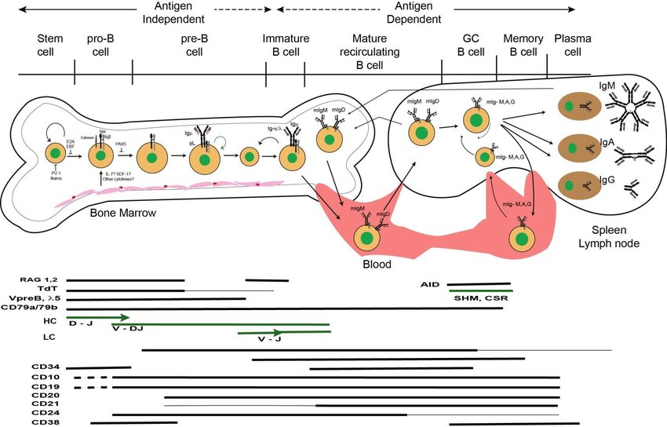
Notes:
During B-cell development, proliferation and differentiation of B cells are dependent on the BCRs and thus absolutely necessary for the development, survival and activation of B cell
B cell development starts in the bone marrow (BM) and continues in the spleen to final maturation.
Developmental progression is guided by sequential events leading to assembly, expression, and signaling of the B cell antigen receptor (BCR).
B cell development begins in the fetal liver and continues in the bone marrow throughout our lives.
Once a B cell can express both μυ and L chains on its membrane, it is officially a B cell.
However, it is still immature and can be easily killed by contact with self antigen until it also expressed membrane IgD.
The mature B cell that moves into the periphery can be activated by antigen and become an antibody-secreting plasma cell or a memory B cell which will respond more quickly to a second exposure to antigen.
B cells which fail to successfully complete B cell development undergo apoptosis (programmed cell death).
Lymphoid progenitor cells receive signals from bone marrow stromal cells to begin B cell development.
Multipotent hematopoietic stem cells (HSCs) in bone marrow give rise to all blood cells that participate in the immune system, follow the basic principles of cell differentiation.
The HSCs first differentiates into multi-potent progenitor cells that can produce both lymphoid and myeloid cells
They then differentiate into the common lymphoid progenitor giving rise to the progenitor-B (pro-B) cells accompanied by expression of transmembrane tyrosine phosphatase CD45R (or B220 in the mouse) and the receptor for interleukin-7 (IL-7)
The IL-7 receptor is composed of an alpha chain (IL-7Rα) and the common gamma (cγ) chain and its signaling leads to B-cell-specific transcription factor expression, induces proliferation, promotes the survival of this progenitor and initiates recombination of the heavy chain locus by recombination-activating gene (RAG) 1 and RAG2
These proteins recognize specific recombination signal sequences (RSS) and cleave precisely in between this and the adjacent gene segment
the high diversity of the receptors is based on two processes: (a) the combinatorial diversity as the V (variable), D (diversity) and J (joining) segments can be combined differently and (b) the junctional diversity arising from imprecise joining.
The rearrangement starts with rearrangement of the D to the JH on both alleles of the HC locus in early pro-B cells, followed by the VH to DJH joining on one allele in late pro-B cells
At the pre-Bl cell stage, DHJ recombination take place on both alleles of IgHC locus, then V to DJ recombination produces HC after allelic exclusion from one of the two alleles resulting in formation of a pre-BCR
The pre-BII cell stage is the first major checkpoint for B-cell development, where the surrogate LC (SLC) assembles with HC as well as, Ig(CD79a) / Ig(CD79b) heterodimer signaling subunits
From pre-B to immature B-cell stages, the ligand independent BCR-mediated tonic signaling act as a critical sensor for B-cell fate decision.
The next checkpoint as Immature B cells leave the bone marrow and migrate to the periphery and differentiate into mature B-cell stages.
Here, mature B cells co-express high amount of IgD and little IgM whereas immature B cell express high amount of IgM on their cell surfaces [51, 52].
Considering immediate precursors of mature B cells, there are transitional 1, 2 and 3 (T1, T2, T3) B cells.
The T1 B cells are IgM high IgD Low CD21- CD23- and can give rise to both T2 (IgM high IgD+ CD21+ CD23+ ) B cells and T3 ( IgM low IgD+ CD21+ CD23+ ) B cells. The B-cell activating factor of the TNF-family (BAFF) microenvironment provides survival signals in transitional and all later B-cell stages to the B cells.
For B-cell development, it is important to generate a large pool of B cells containing a huge variety of BCRs with different specificities and at the same time to avoid development of B cells containing autoreactive receptors, as this may lead to autoimmunity and tissue damage.
The earliest B-linage cells and µ+ pre-B cells can be found in the fetal liver of developing human embryo at the 7–8 weeks of gestation, while sIgM and sIgD positive B cells can be found in the spleen by the 12 weeks [17, 18].
In adult, the B-lymphocytes development from their hematopoietic progenitors (a highly enriched population (3-4%) in bone marrow) continues through a series of micro-environmentally determined signals and events, resulting in the regulatory gene activation or inactivation (shown in fig: 1) responsible for cell proliferation and differentiation [19]
Developing B cells emigrate from the bone marrow as immature B cells predominantly expressing BCRs of the IgM isotype.
In follicular B cells, the IgD BCRs are highly expressed (>90% of the BCRs), transitional B cells express low, and immature B cells express no IgD BCR, whereas IgM BCRs are expressed in immature-B cells after genetic recombination

Slide 8
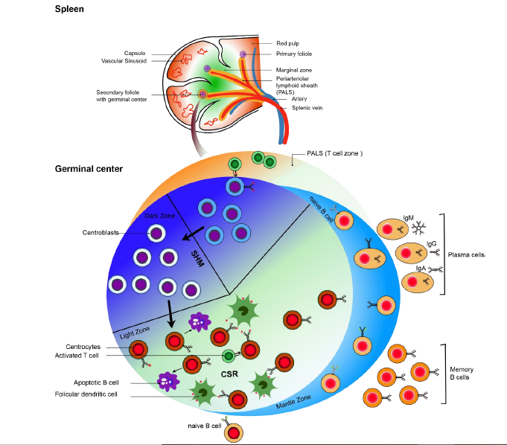
Notes:
Peripheral B cell are divided in 3 different subclasses as marginal zone (MZ) B cells, follicular (FO) B cells and B1 B cells.
As B1 B cells are generated in fetus, the BCR signaling strength determines the fate decision of FO and MZ B cells generation in adult spleen.
Strong signaling favors development of the IgMhigh IgDlow CD21high CD23- MZ B cells, while weak signaling induces differentiation into IgMlow IgDhigh CD21int CD23+ FO B cells
Cells bearing polyreactive receptors are mainly selected to become MZ B cells
These cells populate the marginal zone of the spleen and upon encounter of blood-borne pathogens, the MZ B cells move to the red pulp and undergo a burst of proliferation to form foci of plasma-blasts in a T-independent manner, thereby giving rise to short-lived plasma cells
naïve B2 B cells circulate through spleen, bone marrow, blood, lymph and lymph nodes. Upon encountering their specific antigen and concomitant T-cell help, they differentiate either to short-lived plasma cells secreting IgM antibodies or undergo germinal center (GC) reaction
GCs are compartmentalized in a dark zone where the cells divide rapidly and accumulate mutations in the V-regions of Ig gene (a process referred to as somatic hypermutation) and a light zone where the cells undergo antigen-dependent selection
Class switch recombination generates high-affinity receptors of different isotypes (IgG, IgE or IgA), which elicit distinct effector functions
Together, the GC-reaction generates plasma cells secreting high-affinity antibodies and long-lived CD27+ memory B cells. These expressed high-affinity receptors facilitating a fast and effective immune response against the same pathogen when encountered at second time

Slide 9
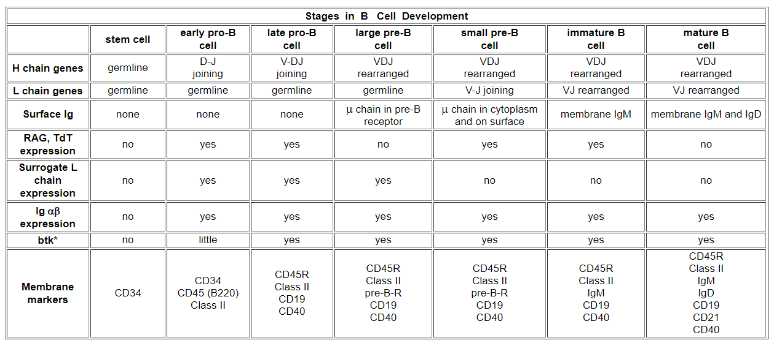

Slide 10
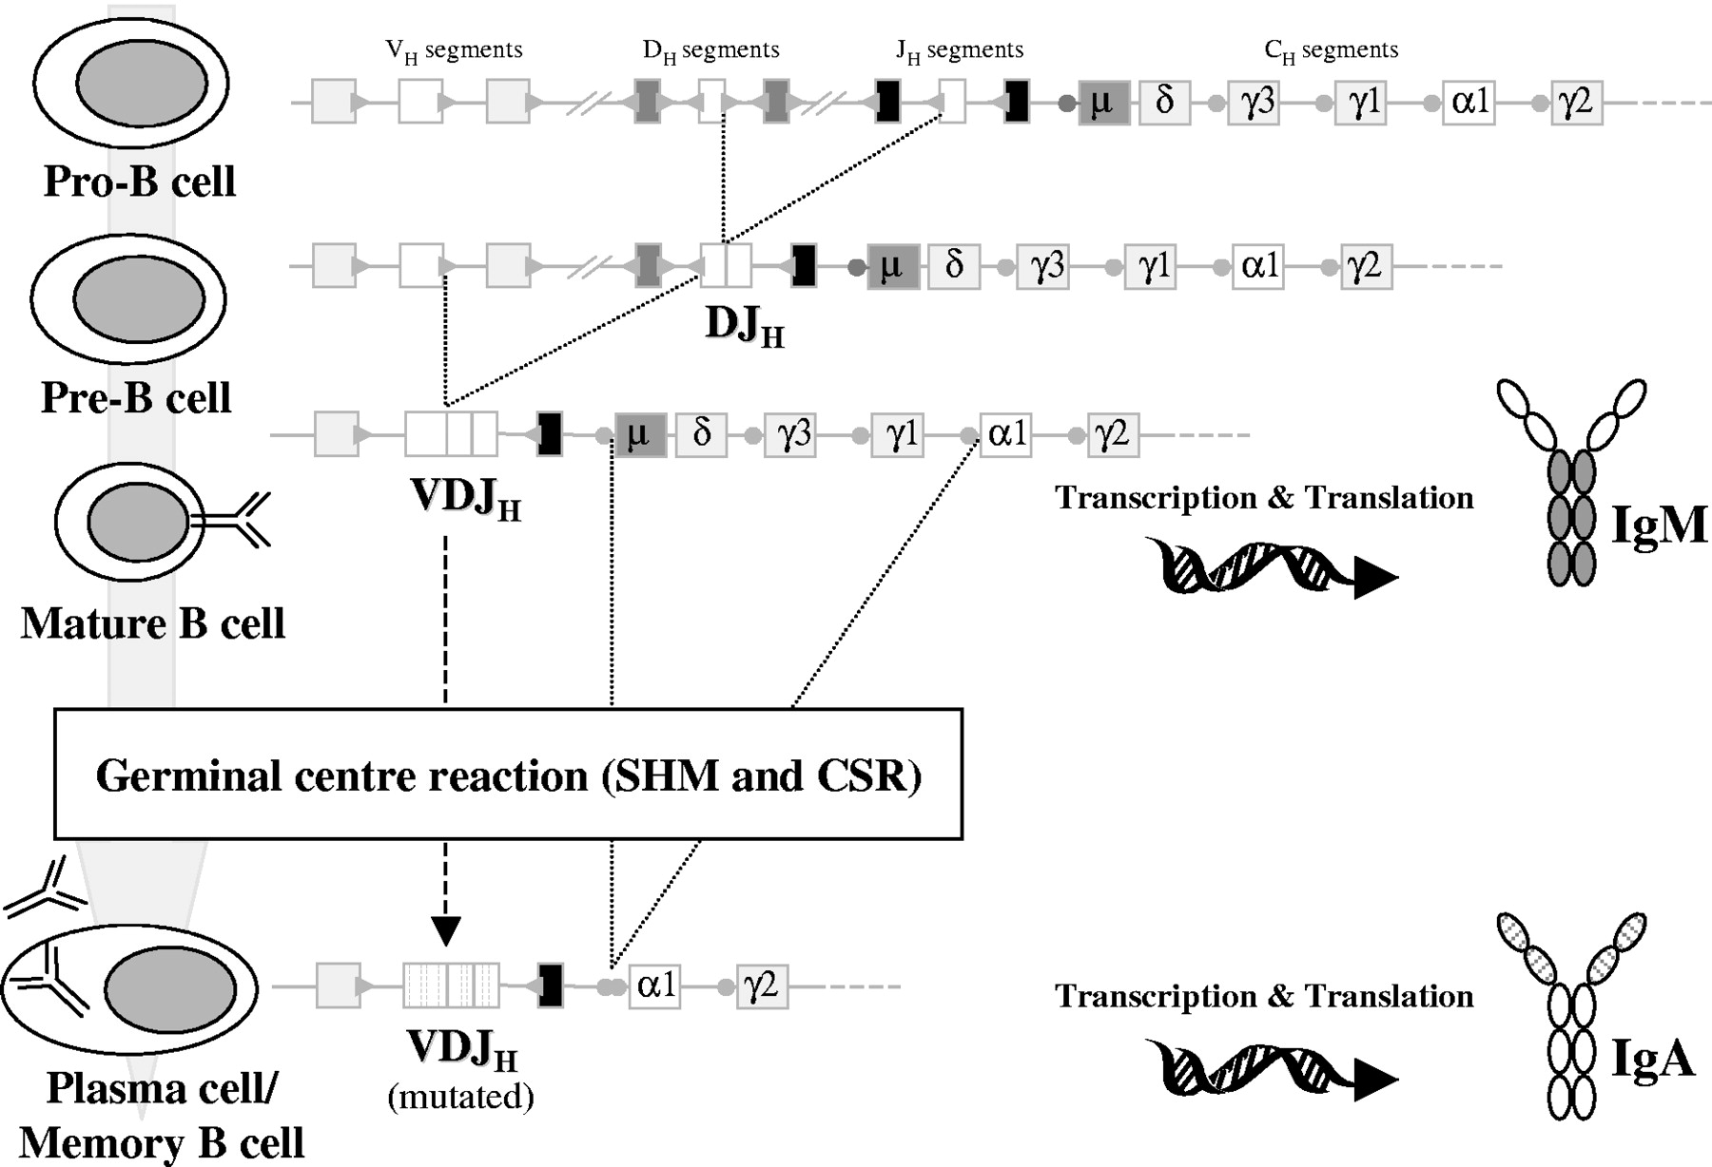
B CELL STAGE
IgH GENE
CONFIGURATION
Stem cell
Early pro-B
Late pro-B
Large pre-B
Germline
D_{H} to J_{H}
V_{H} to D_{H}J_{H}
V_{H}D_{H}J_{H}
Pre-B cell
receptor
expressed
Notes:
During early B-cell differentiation in the bone marrow (BM) the variable (V), diversity (D), and joining (J) gene segments of the immunoglobulin (Ig) genes are rearranged in an ordered fashion to generate the primary Ig repertoire.
Ig heavy chain gene (IGH) rearrangement precedes Ig light chain gene rearrangement, and D_{H} to J_{H} joining precedes V_{H} to DJ_{H} joining.^{1,2}
These rearrangements are mediated by a tightly regulated enzymatic machinery involving several different proteins operating at the DNA level, which are controlled by the recombination signal sequences (RSSs) flanking each gene segment

Slide 11
Heavy and light chain rearrangement is potentially wasteful
V
D
J
C
Germline
V
D
D
J
D_{H}-J_{H} joining
J
C
Large
pre-B
V
V
D
J
C
V_{H}-D_{H}J_{H} joining
With two “random” joins to generate a heavy chain
there is a 1:9 chance of a rearrangement of being in frame
V
J
C
Germline
V
V_{L}-J_{L} joining
V
J
C
With one “random” join to generate a light chain
there is a 1:3 chance of a rearrangement being of frame
Small
pre-B
There is, therefore, only a 1:27 chance of an in frame rearrangement
Out of frame rearrangements arrest further B cell maturation

Slide 12
B cells have several chances to successfully
rearrange Ig genes
Early Pro B
Late Pro B
Pre B
Immature B
D_{H}-J_{H}
On first
chromosome
YES
V_{H}-DJ_{H}
On first
chromosome
YES
κ on first
chromosome
YES
IgMκ
Y
NO
YES
NO
NO
YES
κ on second
chromosome
YES
B
D_{H}-J_{H}
On second
chromosome
V_{H}-DJ_{H}
On second
chromosome
NO
λ on first
chromosome
YES
IgMλ
Y
NO
NO
YES
NO
λ on second
chromosome
B
B
NO

Slide 13
Igα and Igβ in B cell
For signal initiation, the BCR complex requires Ig α also naming CD79a (or MB-1 membrane glycoprotein) and Ig β also naming CD79b (or B-cell-specific glycoprotein B29 )
The Ig α /Ig β heterodimer contains a conserved aa sequence called immunoreceptor tyrosine-based activation motif (ITAM), in which any two aa separate a tyrosine from a leucine or isoleucinegiving the signature YxxL/I
Two of this signature are repeated in the Ig α /Ig β cytoplasmic domain separated by between 6 and 8 aa, giving the signature D/E(X)7-D/E(X)2Y(X)2L/I(X)6–8Y(X)2L/I
Here X represents any aa, D represents aspartic acid, E represents glutamic acid, Y represent tyrosine residues, L and I represent leucine and isoleucine residues

Slide 14
After BCR stimulation, the tyrosine residues of the ITAM become phosphorylated, which results in recruitment and activation of protein tyrosine kinases (PTKs) like Lyn, Syk, Btk. The cooperative action of these PTKs lead to activation of a plethora of signaling pathways such as phospholipase Cγ2 (PLC γ 2) or phosphoinositide 3-kinase (PI3K)
the Igα ITAM tyrosines and Y204 non-ITAM tyrosine are required for efficient pre-B cell differentiation. Igα is differentially N-glycosylated in IgM- and IgD- expressing cells, whereas membrane-proximal extracellular part of μHC and δHC determine the unique glycosylation pattern of the associated Igα molecule

Slide 15
Signal transduction from B-cell receptors
The resting pre-BCRs or BCRs transduce signals through a well-organized signaling complex consisting of several molecules
B cells generate antigen-specific effector cells, recognize antigen and give response by engaging cell surface immunoreceptors
BCRs can give either antigen-induced responses or ligand-independent (autonomous) responses and thereby influence fate decisions of B cells leading to
cell proliferation, differentiation, apoptosis and anergy
BCRs also process antigen by internalization leading to the presentation of antigen derived peptides to T-helper cells

Slide 16
Transduction of signals by the B cell receptor
Extracellular antigen
recognition domains
Igβ
Igα
The cytoplasmic domains of the Igα and Igβ contain Immunoreceptor Tyrosine -based Activation Motifs (ITAMS) - 2 tyrosine residues separated by 9-12 amino acids - YXX[L/V]X₆₋₉YXX[L/V]
Intracytoplasmic signalling domains
Notes:
For signal initiation, the BCR complex requires Ig α also naming CD79a (or MB-1 membrane glycoprotein) and Ig β also naming CD79b (or B-cell-specific glycoprotein B29 )
The Ig α /Ig β heterodimer contains a conserved aa sequence called immunoreceptor tyrosine-based activation motif (ITAM), in which any two aa separate a tyrosine from a leucine or isoleucinegiving the signature YxxL/I
Two of this signature are repeated in the Ig α /Ig β cytoplasmic domain separated by between 9 and 12 aa, giving the signature D/E(X)7-D/E(X)2Y(X)2L/I(X)6–8Y(X)2L/I
Here X represents any aa, D represents aspartic acid, E represents glutamic acid, Y represent tyrosine residues, L and I represent leucine and isoleucine residues

Slide 17
Phosphorylation by Src kinases
Kinase domain
SH3 domain
Unique region
SH2 domain
Enzyme domain
phosphorylates tyrosines
(to give phosphotyrosine)
Phosphotyrosine
receptor domain
Adaptor protein recruitment domain
ITAM binding domain
Phosphorylation changes the properties of a protein by changing its conformation
Changes in conformation may activate or inhibit a biochemical activity or create a binding site for other proteins
Phosphorylation is rapid, requires no protein synthesis or degradation to change the biochemical activity of a target protein
It is reversible via the action of phosphatases that remove phosphate
Notes:
BCR signal transduction starts with the raft associated Src (sarcoma)-family protein tyrosine kinases (PTKs) naming Lyn, Fyn and Blk, those phosphorylate ITAMs of Igα-Igβ in the particular tyrosine motif position at their cytoplasmic tail
Lyn is located in close proximity to the resting BCRs, becomes released from its auto-inhibited stage and subsequently auto/trans-phosphorylated resulting in total activation
Activated Lyn then phosphorylates the first tyrosine in the ITAM-motif of Igα-Igβ enabling the spleen tyrosine kinase (Syk) to bind via its Src-homology (SH)-2 domain, which releases the protein from its auto-inhibition.
Syk activation further enhances the Syk-dependent phosphorylation of upstream Src kinases and ITAMs at adjacent BCR complexes by a positive feedback.
Without antigen stimulation, the ITAM tyrosine-phosphorylation is rapidly removed and only a few SYK proteins will be activated generating a tonic signaling [82].
Syk plays a central role in intracellular BCR signal transduction and induces changes in downstream gene expression.

Slide 18
Regulation of Src kinases
Kinase domain
SH3 domain
Unique region
SH2 domain
Inhibitory tyrosine residue
Activating tyrosine residue
Phosphorylation of ‘Activating Tyrosine’ stimulates kinase activity
Kinase domain
SH3 domain
Unique region
SH2 domain
Phosphorylation of ‘Inhibitory Tyrosine’ inhibits kinase activity
by blocking access to the Activating Tyrosine Residue
Notes:
BCR signal transduction starts with the raft associated Src (sarcoma)-family protein tyrosine kinases (PTKs) naming Lyn, Fyn and Blk, those phosphorylate ITAMs of Igα-Igβ in the particular tyrosine motif position at their cytoplasmic tail
Lyn is located in close proximity to the resting BCRs, becomes released from its auto-inhibited stage and subsequently auto/trans-phosphorylated resulting in total activation.
Activated Lyn then phosphorylates the first tyrosine in the ITAM-motif of Igα-Igβ enabling the spleen tyrosine kinase (Syk) to bind via its Src-homology (SH)-2 domain, which releases the protein from its auto-inhibition

Slide 19
Regulation of Src kinases by Csk and CD45
C terminus
Kinase domain
SH3 domain
Unique region
SH2 domain
Resting cells: Src kinase is inactivated by a constitutively expressed C -terminal Src kinase - (Csk)
Activated cells: a phosphatase associated with the Leukocyte Common Antigen - CD45, removes the C terminus phosphate allowing the activating tyrosine to be phosphorylated
Kinase domain
Kinase domain
SH3 domain
Unique region
SH2 domain
The balance between Csk and CD45 phosphatase activity sets the threshold for initiating receptor signalling

Slide 20
Syk protein Tyrosine kinases
CD45 phosphatase allows activation of Src family kinases Blk, Fyn & Lyn
Receptor cross-linking activates Src kinases that phosphorylate ITAMs in the Igα and Igβ
ITAM
P
ITAM
P
P
ITAM
Syk - 2 x SH2 domains spaced to bind to two phosphotyrosines on an ITAM
P
P
P
P
P
One Syk binds to Igα, one to Igβ - each Syk transphosphorylates the other
Notes:
BCR signal transduction starts with the raft associated Src (sarcoma)-family protein tyrosine kinases (PTKs) naming Lyn, Fyn and Blk, those phosphorylate ITAMs of Igα-Igβ in the particular tyrosine motif position at their cytoplasmic tail
Lyn is located in close proximity to the resting BCRs, becomes released from its auto-inhibited stage and subsequently auto/trans-phosphorylated resulting in total activation
Activated Lyn then phosphorylates the first tyrosine in the ITAM-motif of Igα-Igβ enabling the spleen tyrosine kinase (Syk) to bind via its Src-homology (SH)-2 domain, which releases the protein from its auto-inhibition.
Syk activation further enhances the Syk-dependent phosphorylation of upstream Src kinases and ITAMs at adjacent BCR complexes by a positive feedback.

Slide 21
The B cell co-receptor
CD21
(C3d receptor)
CD45
CD19
Igβ
Igα
CD81
(TAPA-1)
The B cell co-receptor
Notes:
For activating PI3K pathway, both Syk and Src PTKs phosphorylate tyrosine residues on the membrane bound co-receptor CD19 leading to recruitment of phosphoinositide 3-kinase (PI3K) via its regulatory subunit p85.

Slide 22
Co-receptor phosphorylation
C3d opsonised bacterium
C3d binds to CD21, the complement receptor 2 (CR2)
Antigen
recognition
Src family kinases then bind the phosphorylated CD19
P
P
P
P
mIg and CD21 are cross-linked by antigen that has activated complement
CD21 is phosphorylated and receptor-associated kinases phosphorylate CD19
Phosphorylated CD19 activates more Src family kinases
Ligation of the co-receptor increases B cell receptor signalling 1000 -10,000 fold
Notes:
Phosphorylation of phosphatidylinositol-(4,5)-bisphosphate (PIP2) by PI3K then generates phosphatidylinositol-(3,4,5)- triphosphate (PIP3) as a second messenger.
The 3-phosphoinositide dependent protein kinase 1 (PDK1) activates AKT (also called protein kinase B or, PKB) and both are recruited to plasma membrane.
Activated AKT then phosphorylates Forkhead box O (FoxO) transcription factors leading to their nuclear export and subsequent proteasomal degradation thereby inhibiting the transcription of pro-apoptotic molecules and LC gene recombination during the proliferative expansion of pre-B cells, resulting in cell survival.

Slide 23
Activation of signals that affect gene transcription
BLNK
Cell membrane-associated B cell Linker protein - BLNK - contains many Tyrosine residues
P
P
P
P
Tec
Tec
Tec
Tec
BLNK binds Tec kinases
ITAM
P
P
ITAM
Tec kinases activate Brutons tyrosine kinase (BKT)
phospholipase C- γ (PLC-γ)
P
P
PLC-γ cleaves phosphotidylinositol bisphosphate (PIP₂) to yield diacylglycerol (DAG) and inositol trisphosphate (IP₃)
P
P
Activated Syk phosphorylates BLNK
Activated Syk phosphorylates
Guanine-nucleotide exchange factors (GEFS) that in turn activate small GTP binding proteins Ras and Rac
Ras and Rac activate the MAP
kinase cascade
Notes:
AKT also phosphorylate glycogen synthase kinase 3 (GSK3) that inhibit Nuclear factor of activated T-cells (NFAT) transcription factor and stabilizes myc, cyclin-D molecules
Another major signaling event initiated by Syk is the phosphorylation of the adaptor protein B-cell linker [BLNK or, BASH or, SH2-domain-containing leukocyte protein of 65 kDa (SLP-65)] on multiple tyrosine residues, which subsequently serve as docking sites for SH2-domain containing signaling molecules, for instance; the Tec-family kinase Bruton’s tyrosine kinase (BTK), phospholipase C (PLC), the guanine nucleotide exchange factor (GEF) Vav and growth-factor-receptor-bound protein 2 (GRB2)
BTK binds to SLP65 and mediates its activation by Src-kinase dependent phosphorylation and auto-phosphorylation.
Activated BTK then phosphorylates further molecules like PLC, which cleaves PIP2 to generate the soluble mediator inositol-1,4,5-triphosphate (IP3) and membrane-bound diacylglycerol (DAG).
the endoplasmatic reticulum (ER) Ca2+ stores are filled with Ca2+ which bound to the EF-hand of STIM1 in resting B cells.
IP3 binds to IP3 receptor (IP3R) in the membrane of ER (shown in fig: 8a), thereby inducing the release of Ca2+ into cytoplasm from ER. The decreased Ca2+ concentration in the ER leads to Ca2+ dissociation from STM1, resulting further multimerization and translocation of STM1 proteins in ER sites near to plasma membrane
This leads to the activation of Ca2+-dependent proteins such as the phosphatase calcineurin and the calcium-calmodulin dependent kinase (CaMK).
Target proteins of DAG are the protein kinase C (PKC) and proteins of the mitogen-activated protein kinase (MAPK)-family.
Additionally, the MAPK pathway can be activated through GRB2.
The interaction of son of sevenless (SOS) with the small GTPase RAS leads to its activation and subsequently to the activation of the downstream Raf-MEK-ERK (extracellular-regulated kinase) pathway.
Together, the pathways lead to activation of transcription factors such as NFAT (nuclear factor of activated T cells), CREB (cyclic AMP-responsive-element binding) protein, AP-1 and NFκB (nuclear factor κ B) resulting in altered gene expression pattern

Slide 24
Transmission of signals from the cell
surface to the nucleus
B cell-specific parts of the signalling cascade are associated with receptors unique to B cells - mIg, CD19 etc.
Subsequent signals that transmit signals to the nucleus are common to many different types of cell.
The ultimate goal is to activate the transcription of genes, the products of which mediate host defence, proliferation, differentiation etc.
Once the B cell-specific parts of the cascade are complete, signalling to
the nucleus continues via three common signalling pathways via:
The mitogen-activated protein kinase (MAP kinase) pathway
Increased in intracellular Ca2+ mediated by IP₃
The activation of Protein Kinase C mediated by DAG

Slide 25
Simplified scheme linking antigen recognition with transcription of B cell-specific genes
MAP Kinase cascade
Small G-protein-activated MAP kinases found in all multicellular animals - activation of MAP kinases ultimately leads to phosphorylation of transcription factors from the AP-1 family such as Fos and Jun.
Increases in intracellular calcium via IP₃
IP₃, produced by PLC-γ, binds to calcium channels in the ER and releases intracellular stores of Ca⁺⁺ into the cytosol. Increased intracellular [Ca⁺⁺] activate a phospatase, calcineurin, which in turn activates the transcription factor NFAT.
Activation of Protein Kinase C family members via DAG
DAG stays associated with the membrane and recruits protein kinase C family members. The PKC, serine/threonine protein kinases, ultimately activate the transcription factor NFκB
The activated transcription factors AP-1, NFAT and NFκB induce B cell proliferation, differentiation and effector mechanisms

Slide 26
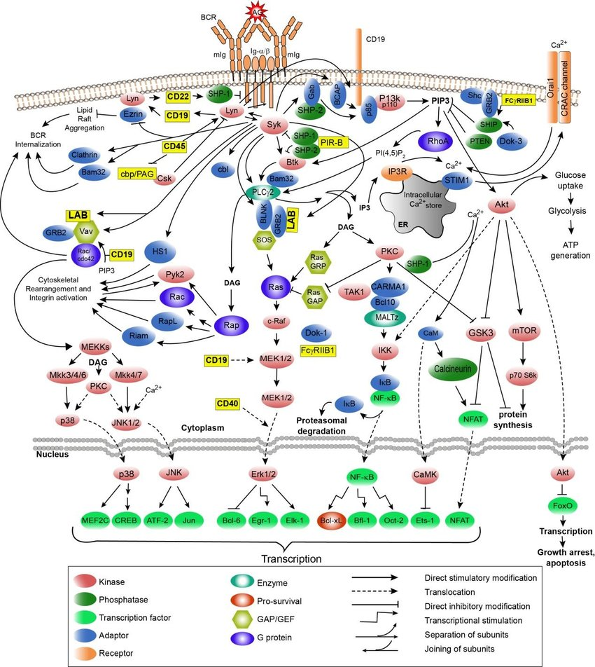
Notes:
For activating PI3K pathway, both Syk and Src PTKs phosphorylate tyrosine residues on the membrane bound co-receptor CD19 leading to recruitment of phosphoinositide 3-kinase (PI3K) via its regulatory subunit p85. Phosphorylation of phosphatidylinositol-(4,5)-bisphosphate (PIP2) by PI3K then generates phosphatidylinositol-(3,4,5)- triphosphate (PIP3) as a second messenger.
The 3-phosphoinositide dependent protein kinase 1 (PDK1) activates AKT (also called protein kinase B or, PKB) and both are recruited to plasma membrane.
Activated AKT then phosphorylates Forkhead box O (FoxO) transcription factors leading to their nuclear export and subsequent proteasomal degradation thereby inhibiting the transcription of pro-apoptotic molecules and LC gene recombination during the proliferative expansion of pre-B cells, resulting in cell survival.
AKT also phosphorylate glycogen synthase kinase 3 (GSK3) that inhibit Nuclear factor of activated T-cells (NFAT) transcription factor and stabilizes myc, cyclin-D molecules
Another major signaling event initiated by Syk is the phosphorylation of the adaptor protein B-cell linker [BLNK or, BASH or, SH2-domain-containing leukocyte protein of 65 kDa (SLP-65)] on multiple tyrosine residues, which subsequently serve as docking sites for SH2-domain containing signaling molecules, for instance; the Tec-family kinase Bruton’s tyrosine kinase (BTK), phospholipase C (PLC), the guanine nucleotide exchange factor (GEF) Vav and growth-factor-receptor-bound protein 2
the endoplasmatic reticulum (ER) Ca2+ stores are filled with Ca2+ which bound to the EF-hand of STIM1 in resting B cells. IP3 binds to IP3 receptor (IP3R) in the membrane of ER (shown in fig: 8a), thereby inducing the release of Ca2+ into cytoplasm from ER. The decreased Ca2+ concentration in the ER leads to Ca2+ dissociation from STM1, resulting further multimerization and translocation of STM1 proteins in ER sites near to plasma membrane

Slide 27
Summary
You should know:
Where B cells come from
What happens to B cells in the bone marrow
How B cell differentiation is linked with Ig gene rearrangement
The B cell developmental ‘check points’ that ensure each cell produces a single specificity of antibody that does not react with self
How B cells transmit information from the shape and charge of an antigen through the cell membrane to allow the expression of genes in the nucleus

